Slide 1


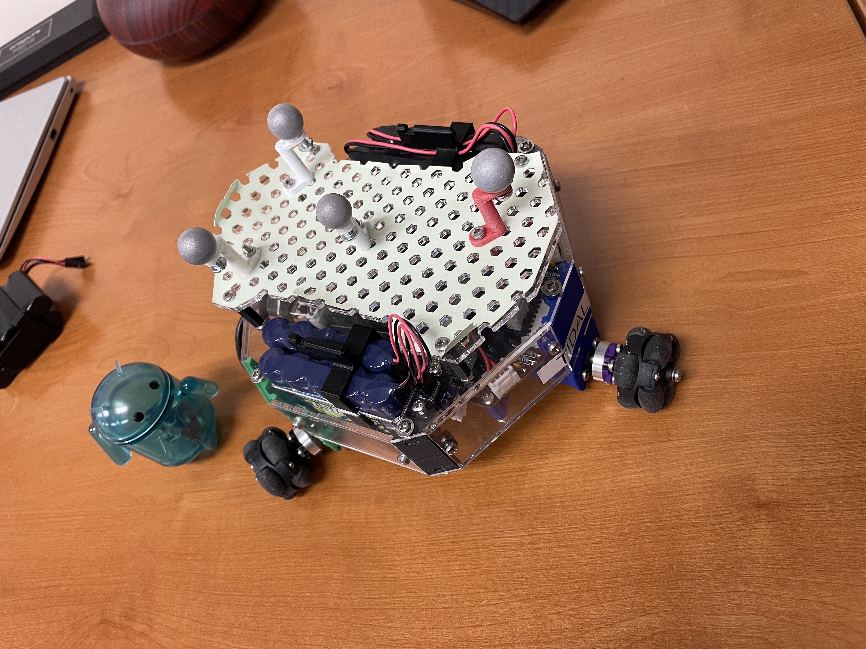
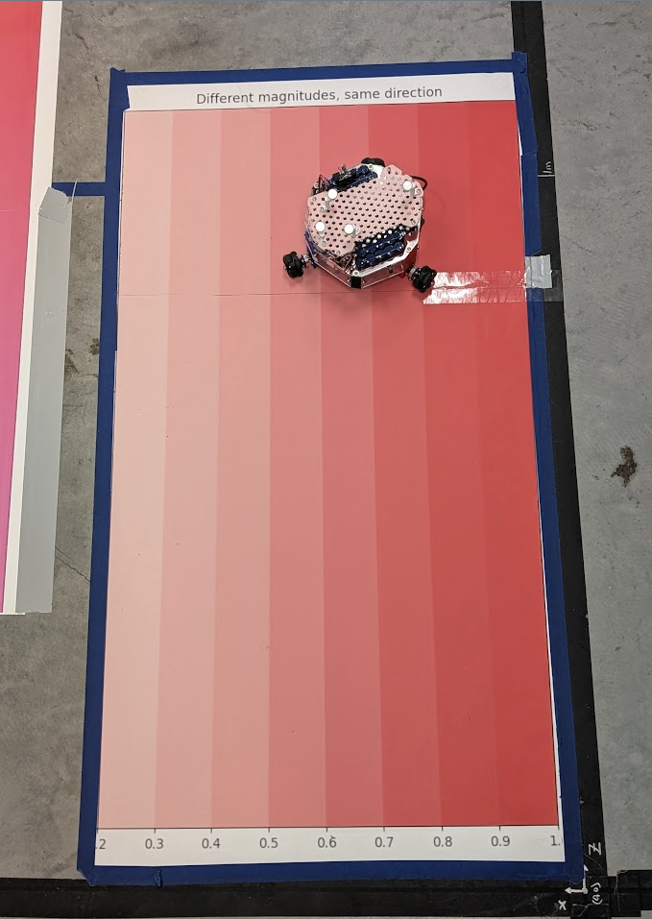
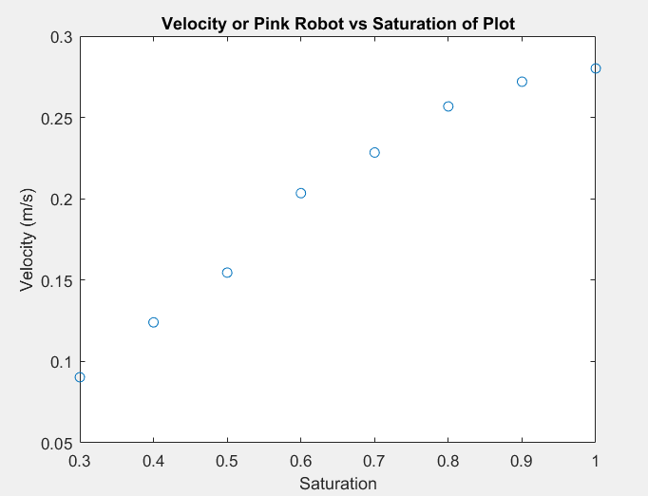
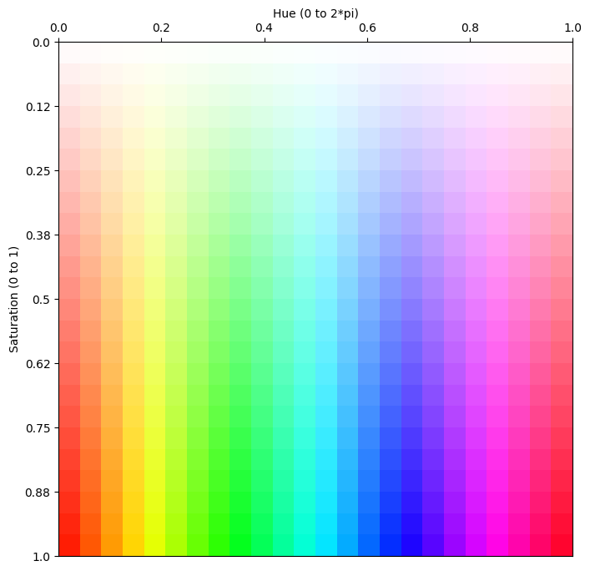
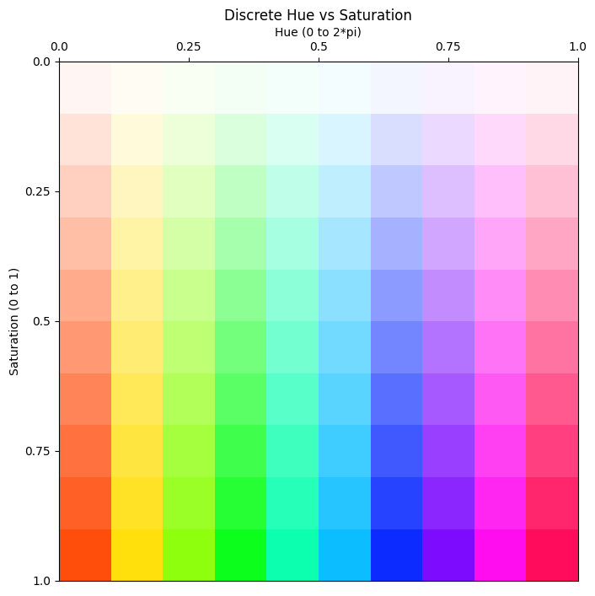
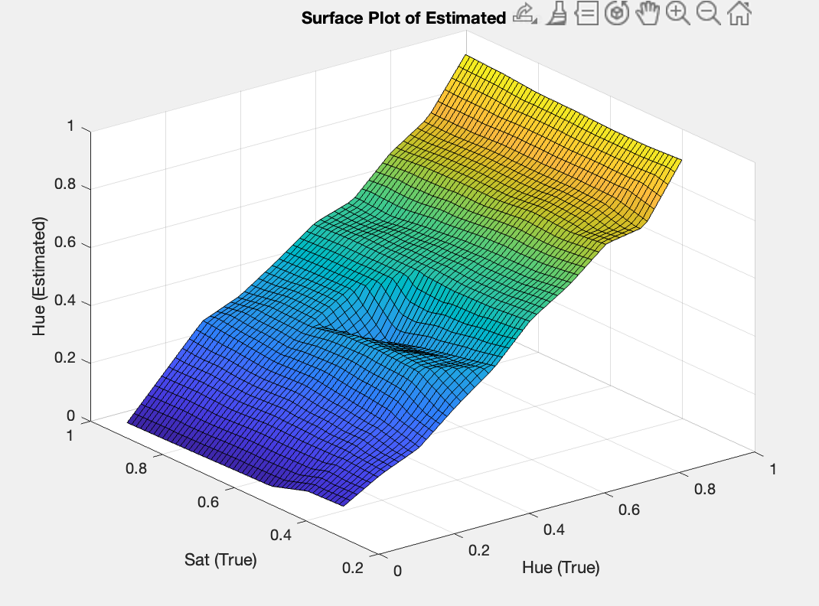
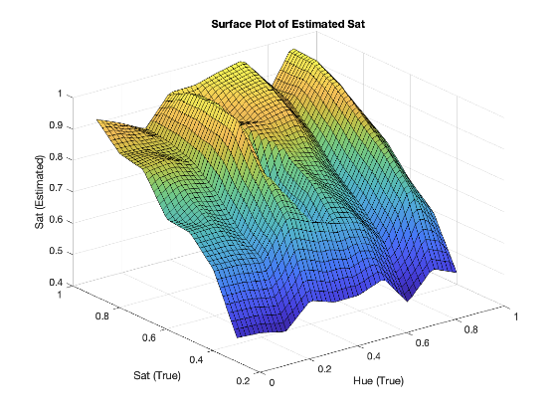
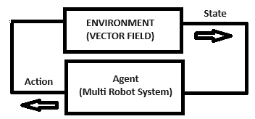
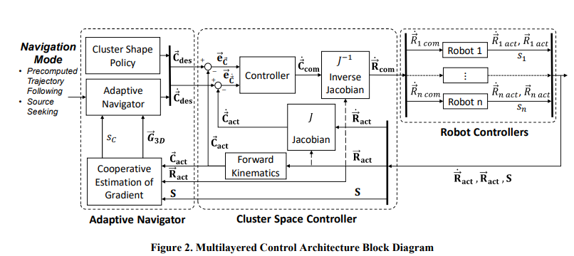
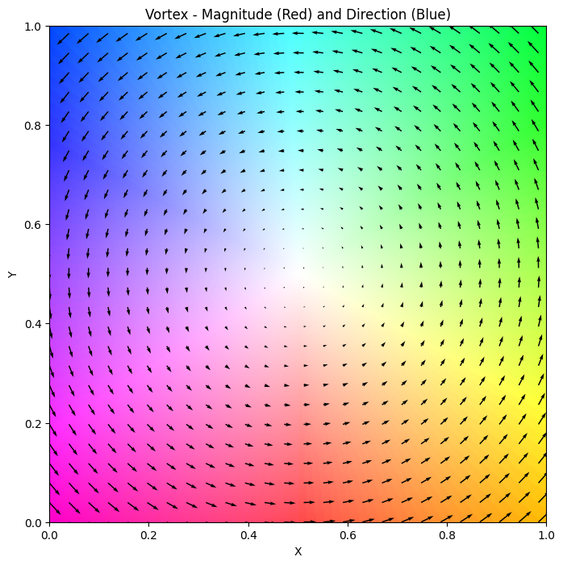
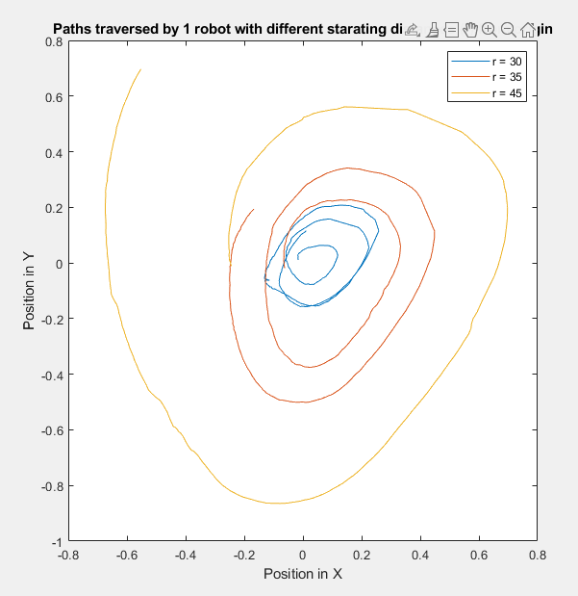
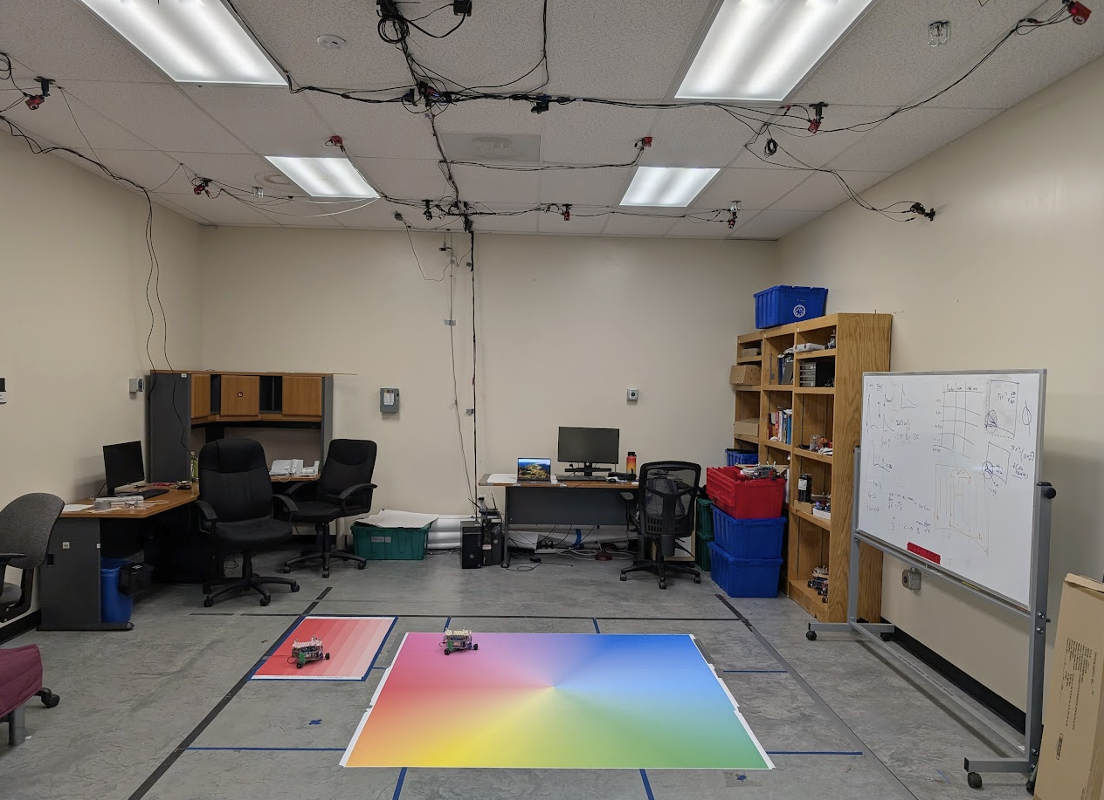
A Functional Indoor Testbed for 2D Vector Field Multirobot Adaptive Navigation
Christopher Waight
Advisor: Dr. Christopher Kitts
Background
Test Bed Design
Results
Significance
Autonomous Navigation of Multirobot Systems (MRS) in physical vector fields is crucial for applications in harsh or communication-denied environments, including disaster response, environmental monitoring, and extraterrestrial exploration. While adaptive navigation in scalar fields is well-established, extending these methods to vector fields presents significant challenges.
Decabot
Saturation to Velocity
This system was able to recover Hue with an RMSE of 0.047 and Saturation with an RMSE of 0.1477. This test bed enables modeling of all possible 2D vector fields, allowing for experimental verification of previous research that was limited to simulation only.
Sampling at 10Hz, a 70x improvement to the last test bed, enables the study of system dynamics as it allows for continuous motion of robots, paving the way for outdoor tests and commercial applications.
Fig 1. Decabot, SCU’s omnidirectional rover equipped with an RGB Sensor
Color Space and Tuning
Problem
Fig 6. Decabot velocity tracked at different Saturation levels
Vector Field environments are often dynamic and have features of interest that change location with time, necessitates Adaptive Control laws. Further challenges arise when bridging the gap from experimental results in Simulation to real world test environment.
Prior work at SCU has demonstrated a test bed using different channels to RGB sensors to represent different vectors. This approach suffered from channel interference, and low sampling frequency, limiting the test beds accuracy and dynamic capabilities
Hue and Saturation Verification
Future Work
Fig 2. Hue vs Saturation pallets used to represent magnitudes and directions. Calibration and verification plots used for linear piecewise tuning.
Next steps for this research include:
Further refining the sensor tuning using non-linear methods to further improve accuracy.
Using the test bed to validate simulations of new control laws to find features of interest in vector fields.
Using the systems ability to model robot dynamics to validate simulated multirobot vehicle dynamics.
Increasing sample rate (if needed).
Control Architecture
Fig 3. Control Actions react to instantaneous information only
Fig 7. Hue and Saturations estimated from verification plot
Objective
MultiRobot Direction Follow Primitive
Conclusion
To develop and validate a new indoor test bed for MRS adaptive navigation in vector field environments. This test bed must:
Accurately represent all vector directions across a wide range of magnitudes.
Allow for continuous robot motion.
Have multi-robot capabilities.
Allow for verification in a quantifiable way.
Fig 4. Control Stack including Cluster Space Controller.
This project was successful in overcoming the limitations of previous work.
The new test bed overcomes the channel coupling issue, and samples 70x faster.
This test bed was also used for experimental verification of results from previous vector field studies that were only performed previously in simulation.
OptiTrack for Verification
Fig 5. Test Bed Under OptiTrack System for position verification
Fig 8. Positions of single robot as follows prescribed vectors

